Slide 1



ESTICOM
Training Programme
Initial findings of the Training Programme
Matthias Kuske, Barrie Dwyer
AIDS2018 Amsterdam

Slide 2
Training Needs of
Community Health Worker

Slide 3




Slide 4
Training Needs
  Limited or no access to trainings (10%, up to 22,5% East-EU)
  No standardized training curriculum
  Theoretical framework missing in half of the trainings
  Most trainings without certification
  Mostly not monitored or evaluated
  Most trainings only cover knowledgebased topics
  CHW miss collaboration / exchange with CHW from other European countries

Slide 5
Training Needs
  Important topics underrepresented, i.e.
    Mental health
    ChemSex
    New prevention technologies, i.e.PReP
    Discrimination / stigmatisation
  Trainings for CHW mostly cover only topics
      CHW already know (knowledge)
      National NGOs & governments are interested in

Slide 6
Training Needs
Gaps all over Europe in regards of
      Attitudes
      Skills, i.e.
        Communication
        Interpersonal
        Service coordination
        Capacity building
Cultural competencies in regards of gay/MSM life, sexuality, (sub-) communities
Management (monitoring & evaluation)

Slide 7
Training Recommendations
Emphasis on competency-based rather than knowledge- based trainings
Integrated conceptual and pedagocial approach strongly recommended
Include innovative approaches (E-Learning)
Core common (European) training protocols -> adapted to local context and enriched by local, national material
Incentives, recognition and certification as crucial motivation component to be considered
Focus on Eastern Europe (most training gaps)

Slide 8
Training Needs & Recommendations

Slide 9
Overview Training Material & Programme

Slide 10
Overview
Piloting of the first Europe wide provision of training for Community Health Workers covering a wide curriculum.
Contains three ‘arms’
  Development of the ‘toolbox’ Training Materials in module form (40 to 50 hours of training)
  Development and provision of the Training of Trainers sessions
  Support and provision for National Pilot Trainings
Linked to the two surveys just presented
  EMIS 2017
  ECHOES – review of CHW training provision and survey of CHW training needs

Slide 11
Overview
The materials also contain a Needs Assessment Tool and Evaluation Tool and suggested Curriculums to guide the choice of materials
All materials for both the Training of Trainer Workshops and the Training Modules were developed using both the pedagogical approach (choosing identified subjects for module development) and an andragogical approach (using the experiences of the participants and facilitators present)

Slide 12
Training material development
The training materials were developed under four modules, each with their own aim.
  Aim One: To increase the access to prevention, including testing services for HIV, STI’s and Viral Hepatitis among MSM and priority sub-groups.
  Aim Two: To improve the linkage and retention in care, as well as quality of care, including treatment for HIV/AIDS, STI’s and Viral Hepatitis.
  Aim Three: To improve the integration of services to ensure patient centred care, including in-patient and out-patient facilities, including Community & Prison Health Services.
  Aim Four: To reduce stigma and discrimination due to sexual orientation and of people living with HIV/AIDS in healthcare settings, including prison health services and in the community.

Slide 13
Training materials
Training modules developed to meet these aims include:
  Cultural Competency strategies to remove barriers to access; improve quality of services and retention into care; Patient Involvement; Peer Mentoring; Capacity Building and Community Engagement.
  Vulnerable MSM subgroups and subsequent sexual health needs: MSM Youth; MSM Migrants; Non Gay/Bi identified MSM; MSM from ethnic or cultural minority groups; Trans* MSM; MSM with drug (Chemsex) and alcohol needs; MSM in prison settings.
  The epidemiological dynamics of HIV infection among MSM in Europe.
  Syndemic Production Model on intertwining factors for poor sexual health for MSM.
  New Prevention Technologies: TasP; PEP; PrEP; Self Sampling/Self Testing

Slide 14
Facilitator Manual & Participant Workbook

Slide 15
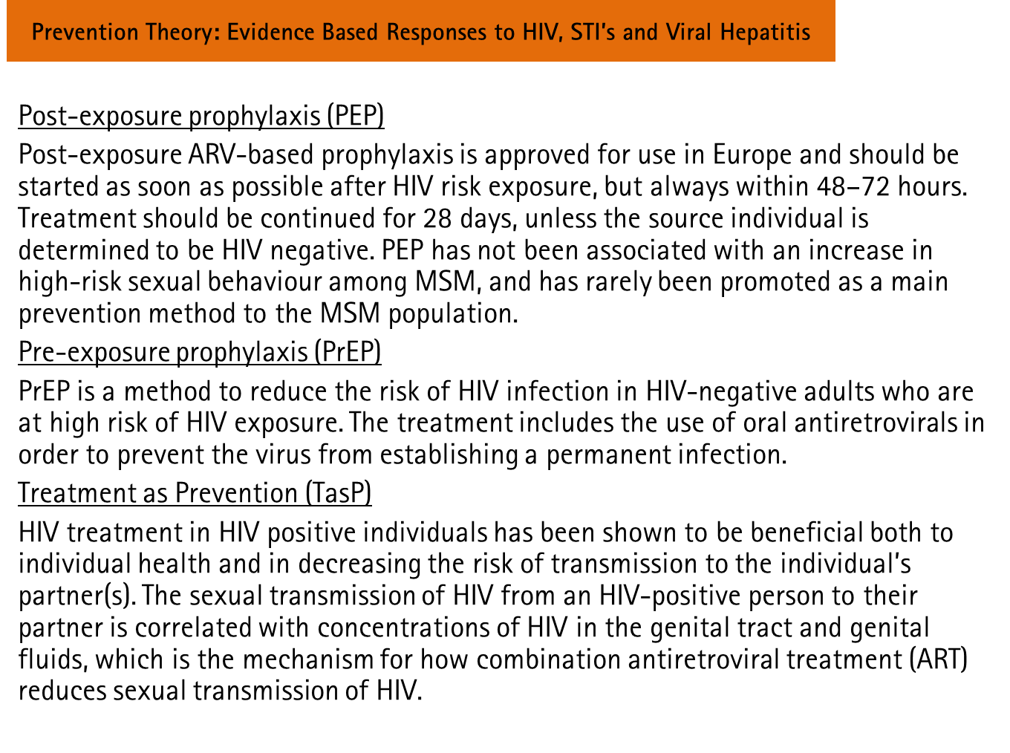
Powerpoint slides & E-learning tool

Slide 16
Curriculum
Four curricular formats devised:
  Curriculum A: Skills
  Curriculum B: Basics
  Curriculum C: Good Practice
  Curriculum D: Development
Used the 7 point procedure to help build
Diagnosis of needs/formation of objectives/selection of content/organisation of content/selection of learning experiences/organisation of learning experiences/determination of what to evaluate and the ways and means of doing it
Incorporates the Pedagogical and Andragogical approaches

Slide 17
Evaluation
Pre and post evaluation, both learner and programmer evaluation.
Evaluate skills and knowledge acquired
Use of variety of assessment methods such as self, peer and ipsative.
Ongoing evaluation of theory and knowledge into practice – what are we trying to affect and have we done so?
Encourage self reflective practice e.g. Gibbs, Rolfe etc.

Slide 18
Needs Assessment
Follows closely the outlines suggested within the ECHOES survey
Assessment of skills, knowledge and comfort levels of CHW’s across the range of issues contained within the training package
Needs assessment will indicate issues to cover within local trainings

Slide 19
Output
Training of Trainers guide plus supporting process documentation
Toolbox training modules for both face to face and e-learning translated into 10 languages
Evaluation, Needs Assessment and Curricular tools
Finalised version: end of August 2019

Slide 20
Overview
Pilot Training Programme
January – October 2018

Slide 21
Training of Trainers Workshops
January - April 2018

Slide 22
Training of Trainer Workshops (ToT)
  4 ToT Workshops: Berlin, Warsaw, Vilnius, Athens
  61 participants from 27 countries
  All EU member countries except Luxembourg, Malta, Slovakia
  2 weekends each
    Selected ESTICOM material & excercises
    Needs Assessment
    Preparation for National Pilot Trainings
    Training facilitation

Slide 23
ToT evaluation
Perceived as useful for working as CHW and as trainer - would recommend the ESTICOM trainings to colleagues
Training material found useful, some participants already use ESTICOM material
      In the work as CHW with their clients
      In their trainings
Better understand the challenges to work as CHW, broader scope
Changes in mind and skill-set (gay men identities, sexual attitudes & needs, non-judgemental services etc.)
Exchange / learning from each other / building a CHW network

Slide 24
National Pilot Trainings
May - October 2018

Slide 25
National Pilot Trainings (NPT) implemented
Russia (18.-20.05.)
Romania / Moldova (15.-17.06.)
Poland (22.-24.06.)

Slide 26
NPT on hold
The Netherlands
Ireland
Bulgaria
Slovenia
Portugal Lisboa

Slide 27
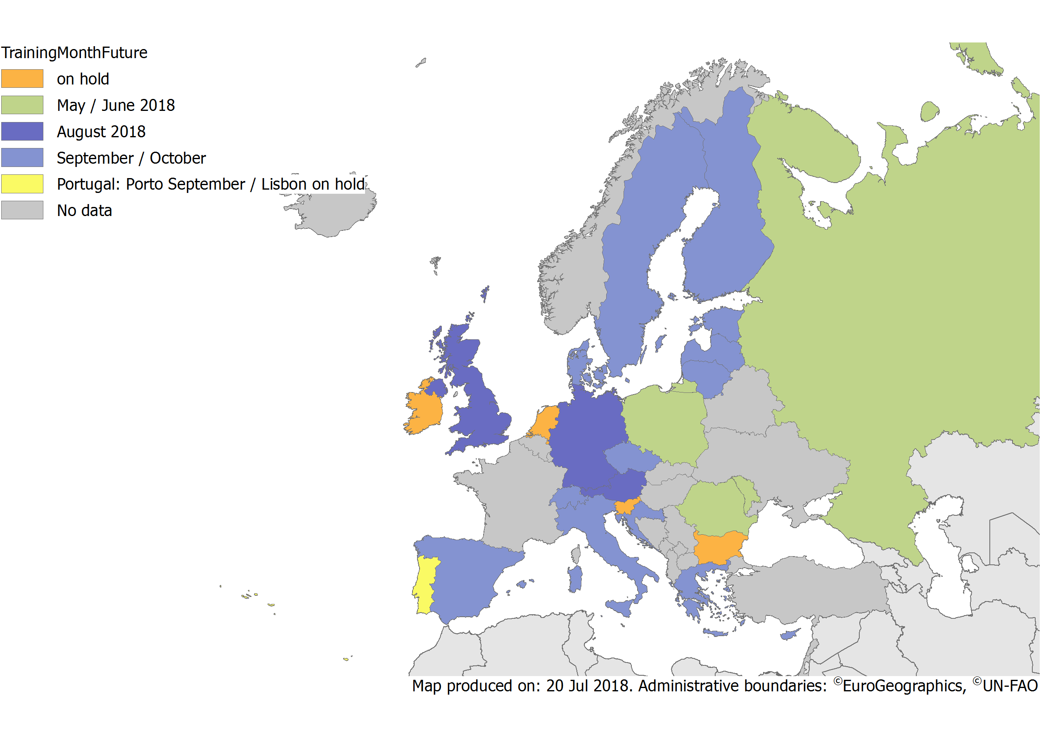
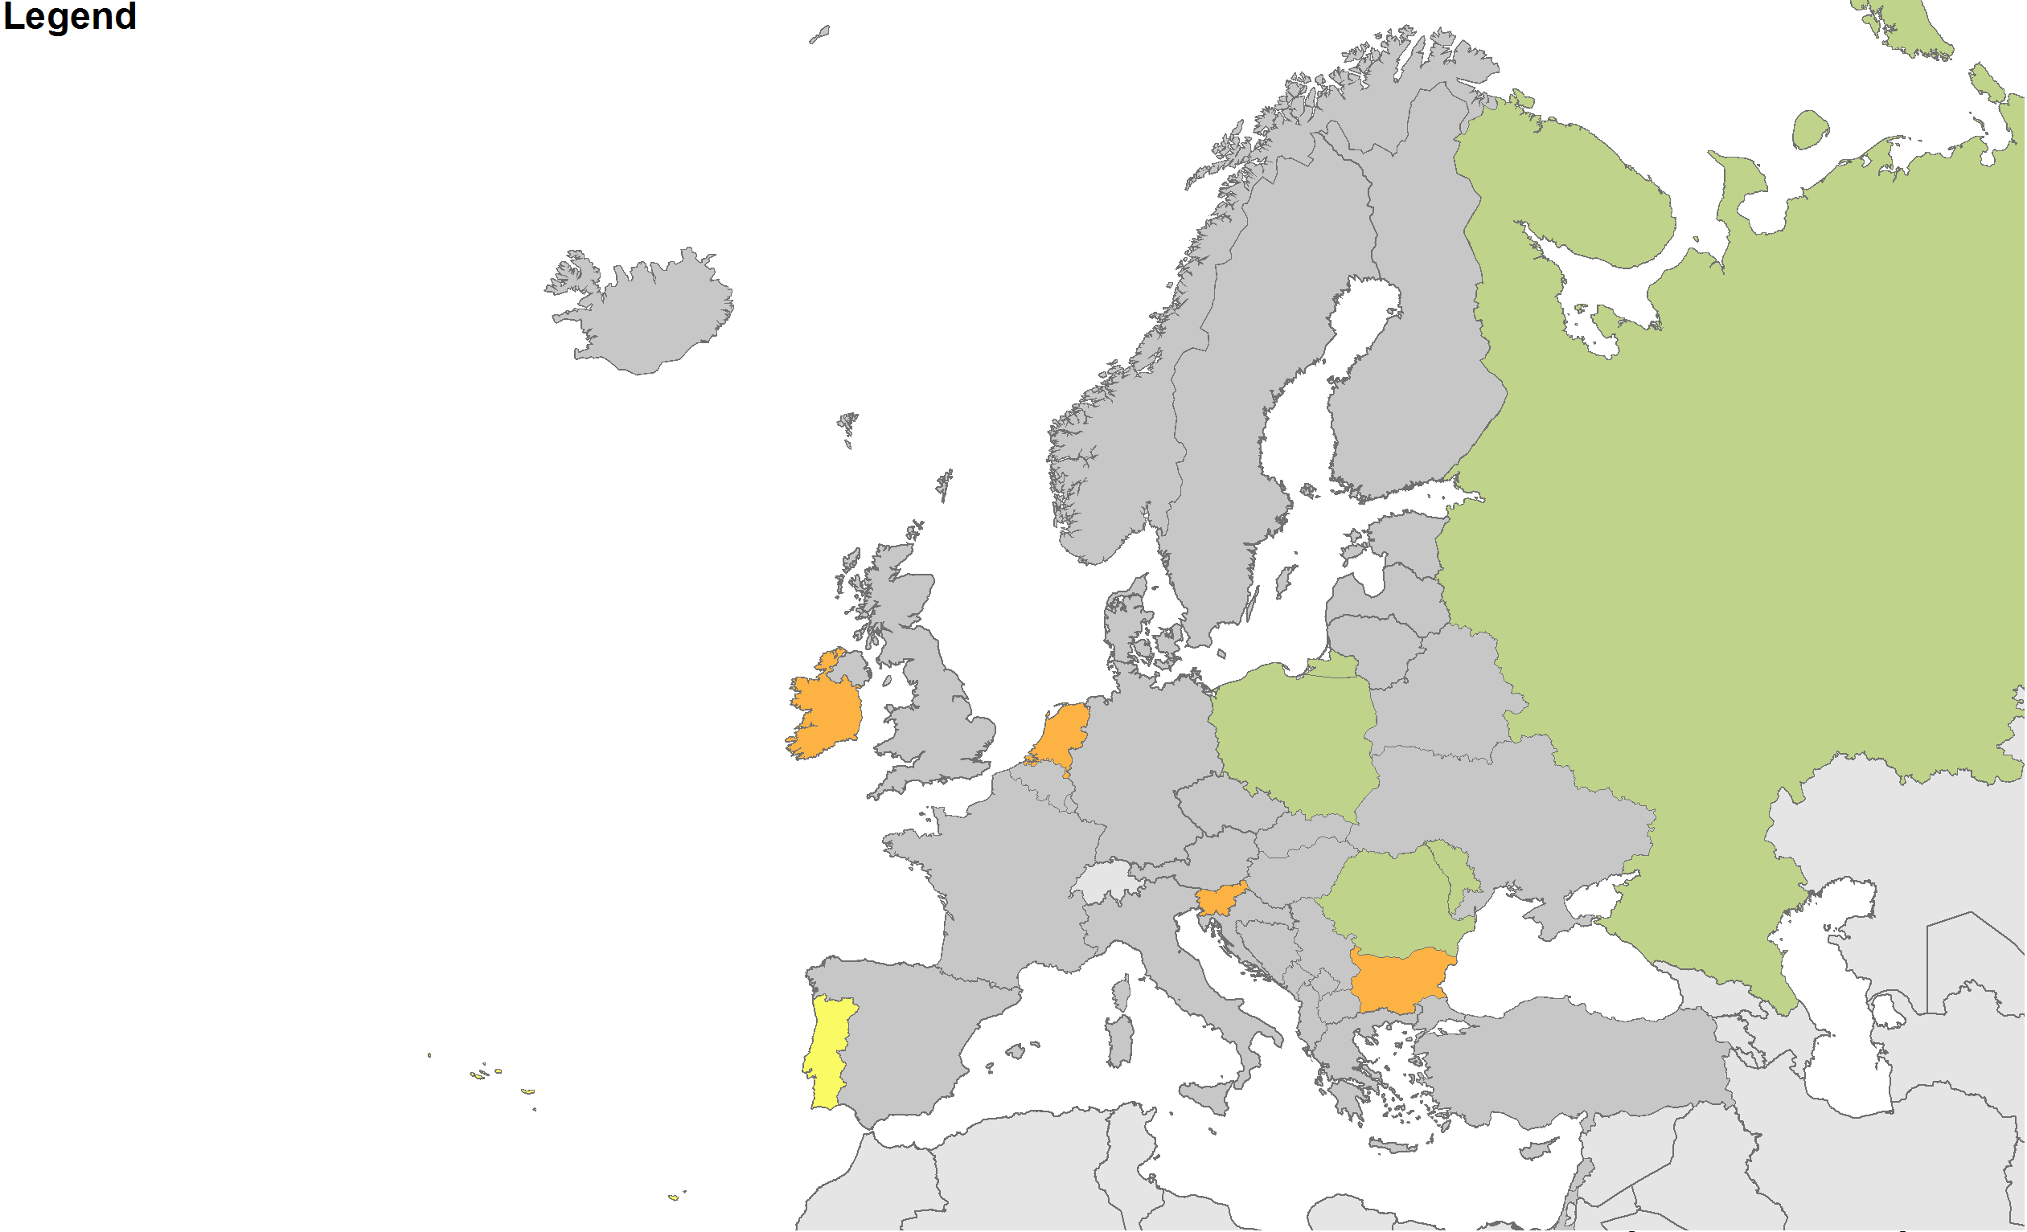
on hold
May / June 2018
Portugal
Porto in September
Lisbon on hold

Slide 29
NPT planned
17+ NPT incorporating 21+ countries will be conducted
England (15.-17.08.)
Germany (17.-19.08.)
Austria (27.-28.08.)
Spain (14.-16.09.)
Greece / Cyprus (17.-19.09.)
Portugal Porto (20.-21.09.)
Croatia (21.-23.09.)

Slide 30
NPT planned
Switzerland (26.-28.09.)
Italy (28.-30.09.)
Czech Republic (04.-05.10.)
Baltic Countries (LT, LV, ES) (05.-07.10.)
Finland (12.-14.10.)
Sweden (12.-14.10.)
Denmark (26.-28.10.)

Slide 31
Initial general learnings
ESTICOM approach successful – enriches the common trainings
      Focus on attitudes and skills
      Cultural competencies
Synergy / collaboration with national training programmes crucial to success of the programme
Implementation strategy and constant coordination needed
Facilitator‘s role (safe space, friendly environment, flexibility, facilitator – not teacher) crucial
Access to the material has to be made as simple as possible

Slide 32


Contact: matthias.kuske@dah.aidshilfe.de barrie.dwyer@tht.org.uk
© Can Stock Photo / dizanna

